Slide 1

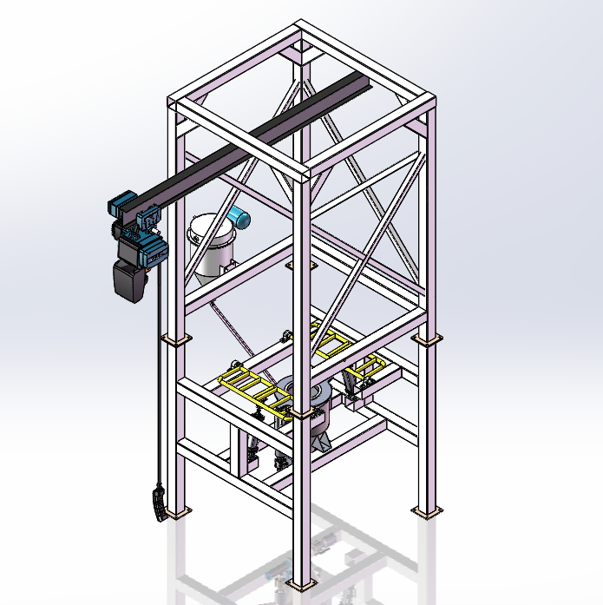

SHANGHAI YOUWEI Bulk Bag Unloading Stations
Systems and Solutions for the
Hygienic and Safe Handling of Powders
for the Chemical, Food, Pharmaceutical and Pigment Industries
www.uv-powder.com

Slide 2

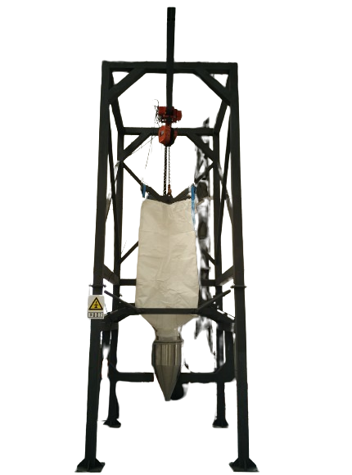
Bulk Bag Unloading Stations
contained and prevents material that has collected on the underside of the bulk bag from contaminating the product.
The YOUWEI’S BBU Station features:
Unloading capability for Bulk Bags up to 2 tons
Modular design
Custom configuration
Heavy duty tubular frame construction suitable for today’s industrial use
Carbon steel painted or all stainless steel frame
316L/304L Stainless steel contact parts
Low profile
Loading by fork lift or with integrated crane and hoist
Dust-free connection and emptying of Bulk Bags
Dust aspiration during the change of a Bulk Bag
Contaminant free bag loading – no foreign matter from the bottom of the bag enters the material flow
Optional lump breaker and extra agitator
Flow assisting massagers or vibration assistance
Dust filter option
Combined systems with Bag Rip-and-Tip Station available
Vacuum conveyor interface
Built to be used independently or as part of a complete YOUWEI’S conveying system, our Bulk Bag Unloading Station (BBU) is engineered and
manufactured to the same exacting quality standards as our vacuum conveyors.
Its modular design allows you to customize the unit to meet your specific usage requirements in either a hoist or forklift configuration. In addition, the BBU is designed to optimize dust-free material flow from the bag to the vacuum conveyor and down line processes without any contamination of the material or work environment.
It does this by using a patent-pending dust tight discharge chute connector, which keeps product flow
BBU options include:
Massaging paddles with pneumatic actuators
Manual or pneumatic covering for the material discharge module
Material agitator
Material delumper
Dust collector
YOUWEI’S conveyor interface

Slide 3
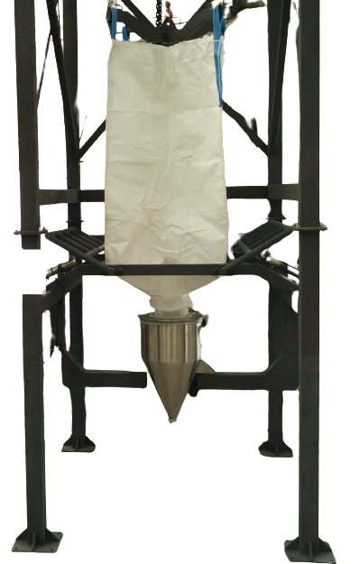
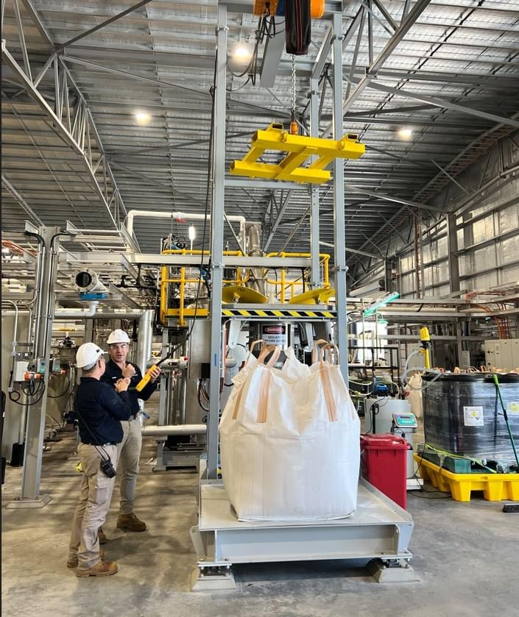
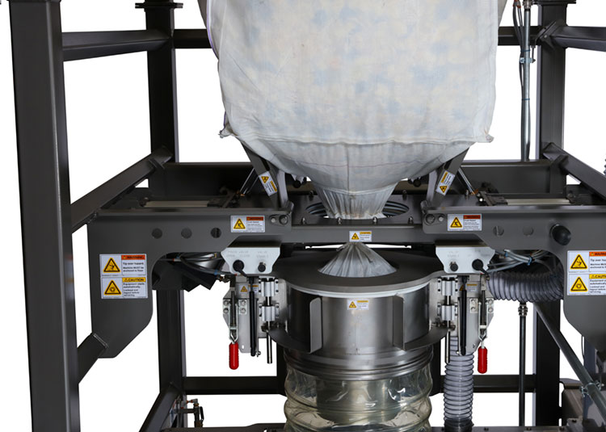
Bulk Bag Unloading Stations
Contained Dust-Free Bag Connection
Adaption of the Big Bags on Docking Station
Manual Adjustment Via Two Arms
Massager Unit to Assist Discharge

Slide 4
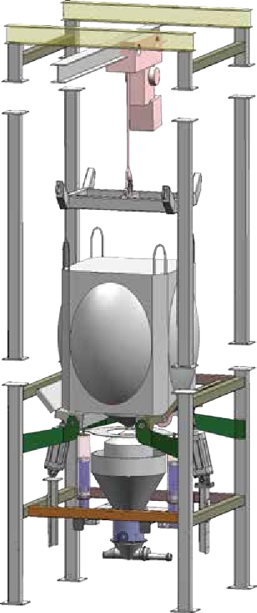
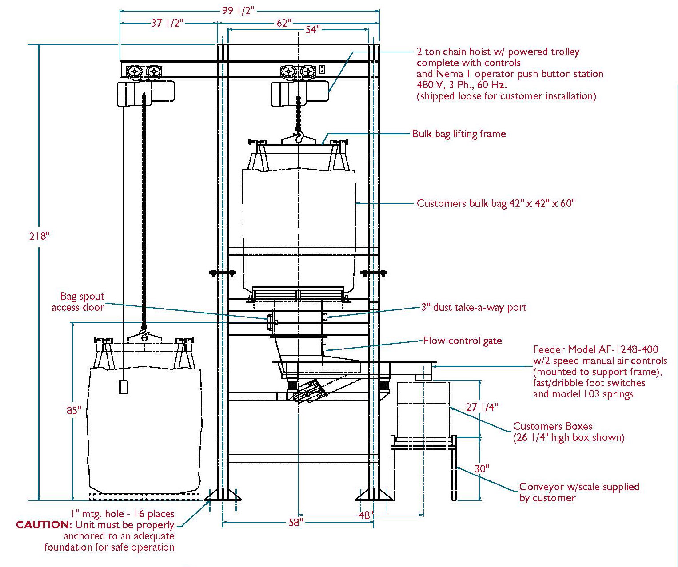
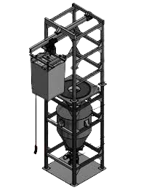
Bulk Bag Unloading Stations
LEFT: The BBU‘s modular design offers tremendous flexibility in meeting individual production requirements.
Loading element with crane mounting and rod.
Electric chain winch with passive or active trolley.
Frame extension set.
Optional massage paddles with pneumatic actuators.
Dust-tight bag connector.
Bag support rods.
Vacuum conveyor interface.
1
2
3
BBU Bag Dimensions
4
5
6
7
Hoist static BBU.
Schematic of forklift static BBUone.

Slide 5
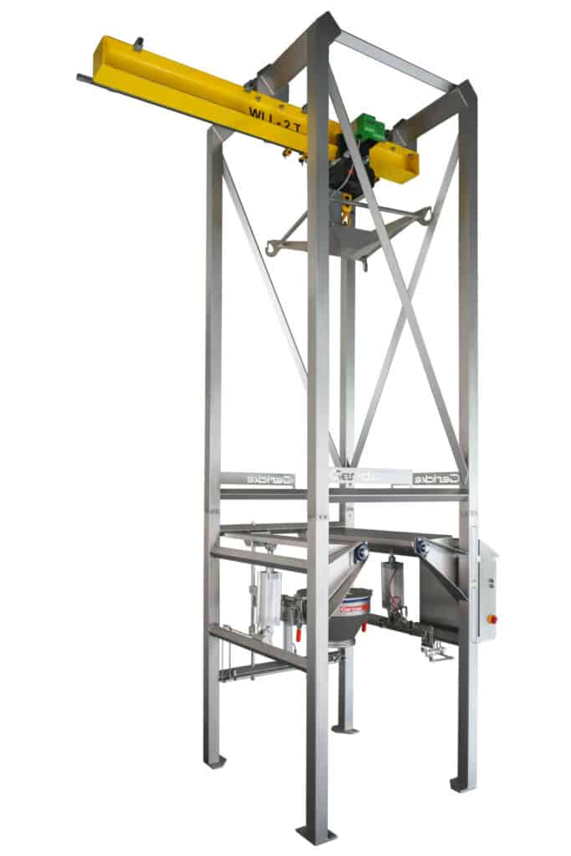
Bulk Bag Unloading Stations
Powder materials are packaged in ton bags and large bags to quickly complete the unloading work without generating dust during the unloading and feeding process. Use electric hoist or crane to lift the ton bag to the discharge port. Manual bagging is guided and automatic bag clamping is completed. After clamping the bag, loosen the tie, operate the hoist to automatically lift, and the material falls. Ton bag unloading station The bottom of the ton bag unpacking machine can be connected to the vacuum loader pipe to complete the lifting function. The equipment has a flexible structure and can be directly installed on the material receiving equipment. Such as mixers, reactors, dissolving tanks, etc.
Work Description:
The system is composed of a lifting hanger, a big bag beating device, a pneumatic entrainment device, a buffer tank, weighing, screw conveying and a discharge pipe. The large bag opening station is used for unloading bagged materials and is a semi-automatic operation. The big packaging bag is lifted by an electric hoist (pneumatic hoist). The bag rope of the packaging bag is hung on a rigid bracket. The hoist is lifted, lowered and walked manually. It runs along the walking guide rail to the top of the unloading area and puts the big bag in the unloading position.
Press the button, the clamping cylinder rises, the operator pulls the discharge of the packaging bag to the inner ring of the bag clamp, presses the clamping button, the clamping cylinder descends, and the sealing ring presses the inner ring of the bag clamp to clamp the bag mouth tight. At this time, the operator opens the rope tie at the discharge port of the ton bag, and the material begins to be discharged through the inner ring of the bag clamp. There is no dust leakage during the discharge process, and the material begins to be discharged along the pipeline under the action of gravity.
During the unloading process, in order to make the materials flow smoothly in the packaging bags and pipes, a bag-beating device is added to loosen the materials. The material falls into the buffer tank after being beaten, and is evenly transported to the discharge pipe part by the screw, and finally reaches the equipment designated by the customer.
After the unloading is completed and the bags are tied manually, the bag clamp button is turned on, the bag press rises, the manually operated electric hoist rises, and the empty bags are lifted out.

Slide 6
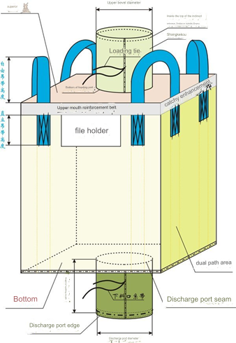
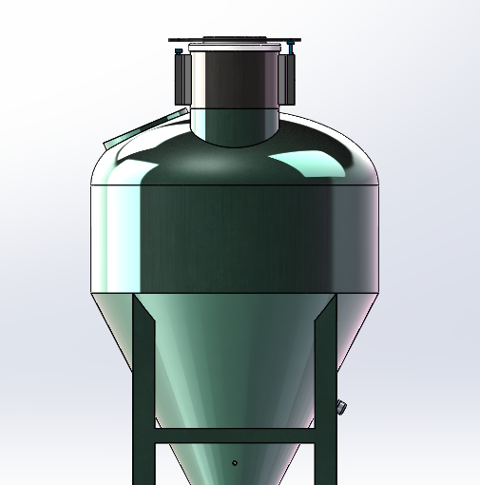
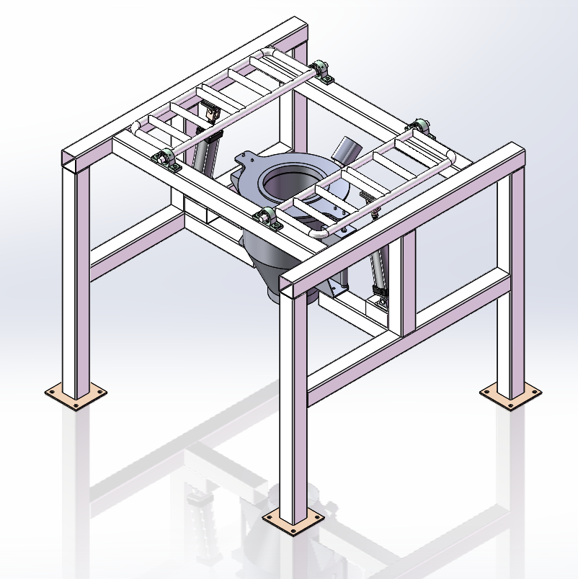
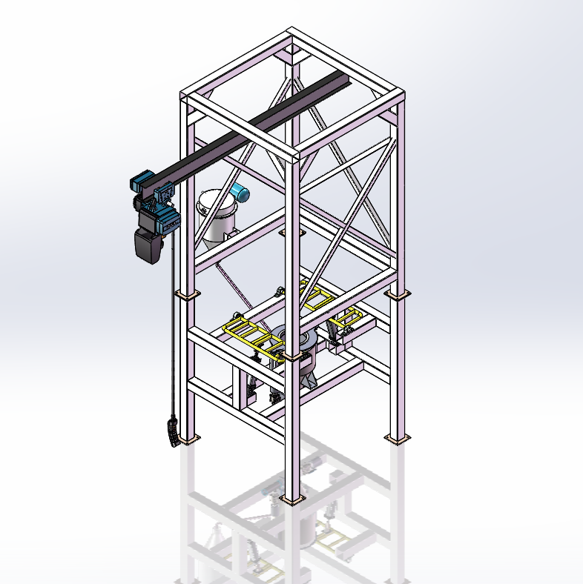
Bulk Bag Unloading Stations
Selection parameters：
Name (see picture)） | value
Sling height | （ ）MM
Ton Bag height | （ ）MM
Discharge port diameter | （ ）MM
Discharge port height | （ ）MM
Gross weight | （ ）KG
Please provide the above parameters for equipment selection.
Application method：
1. The unloader is installed on the silo or mixing equipment. 2. Bring half the money for driving by yourself. 3. Equipped with electric hoist dust removal equipment.。
Technical Parameters：
Model | Material | Power | Dust removal | Size
XLQ | Stainless steel 304 | 0 | none | Φ490*680
XLZ-1 | Carbon steel/stainless steel 304 | 0 | none | 1600*1600*1480
XLZ-2 |  | 3KW | exist | 1800*1800*4800
XLZ-3 |  | 5KW | exist | 2000*2000*6000

Slide 7
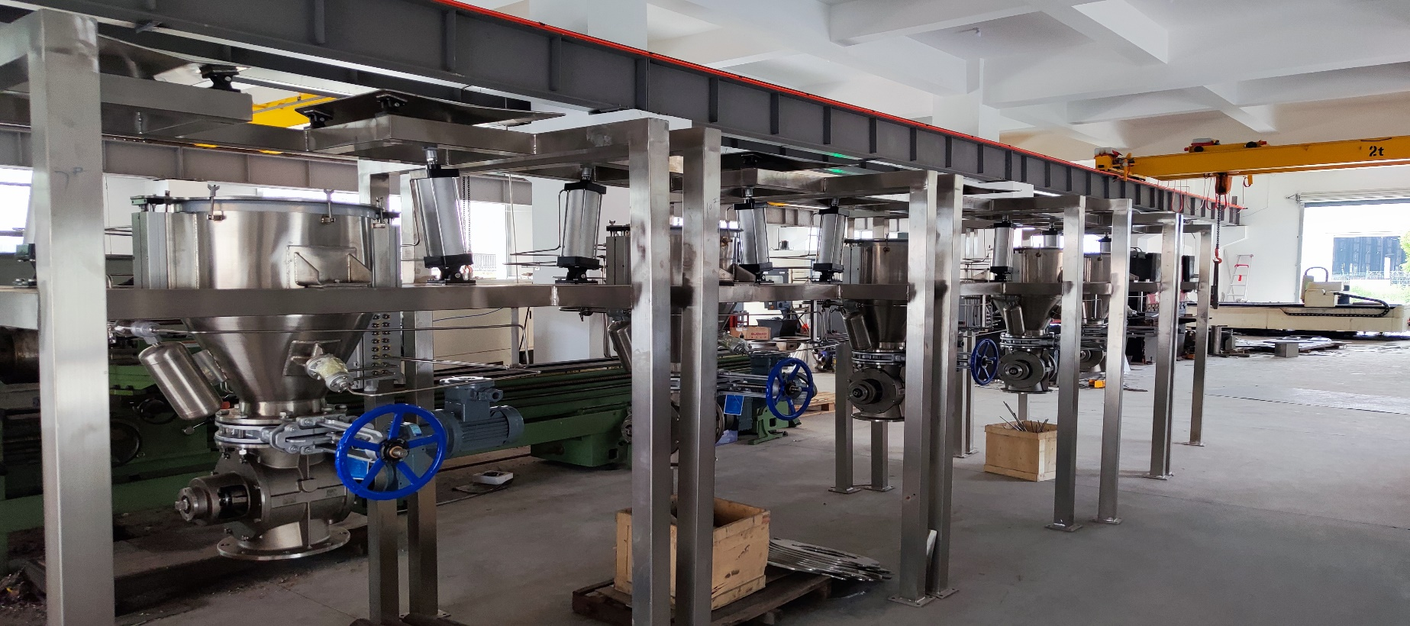
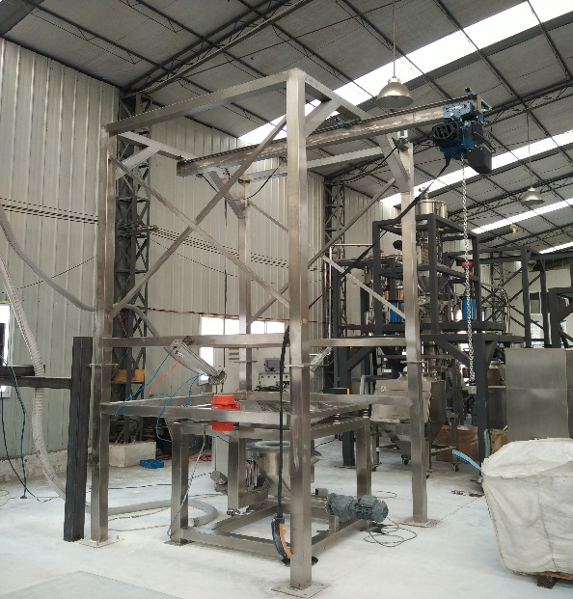
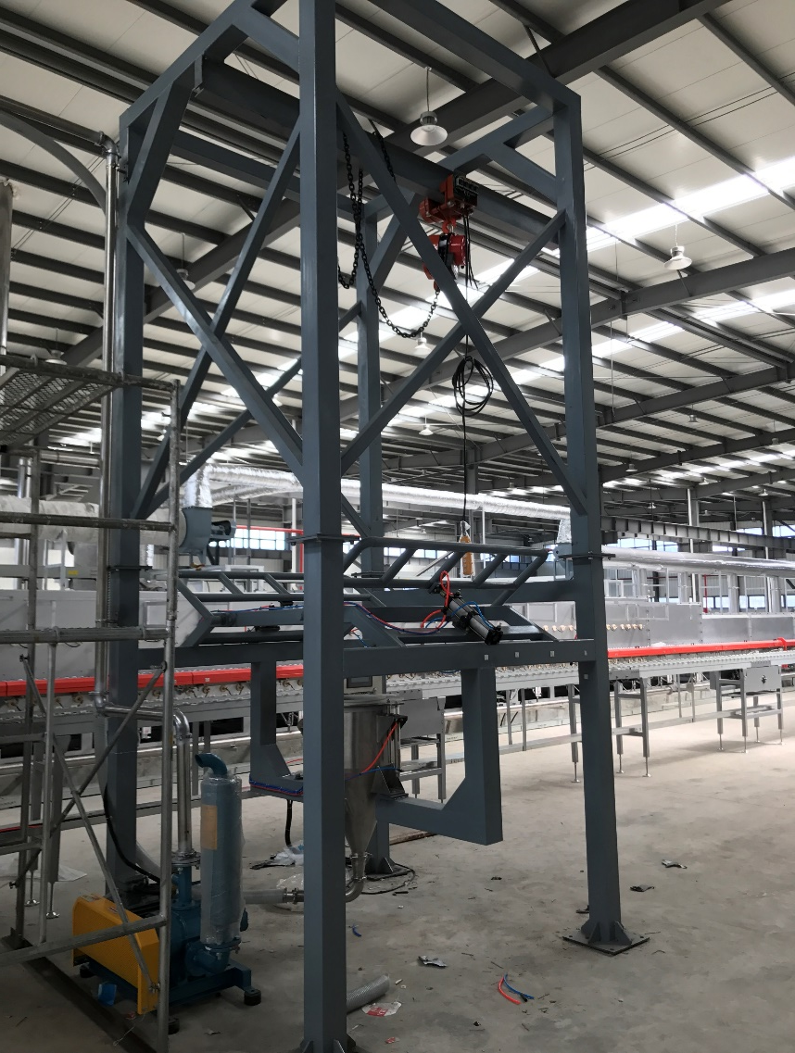
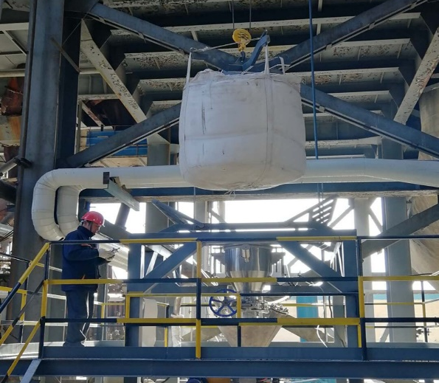
Bulk Bag Unloading Stations
Device photos:

Slide 8
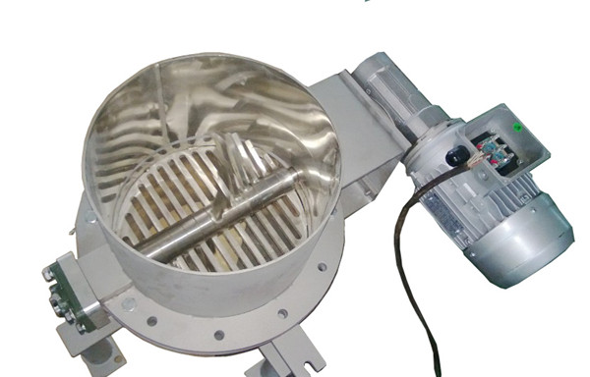
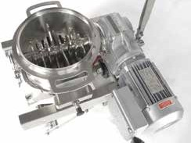
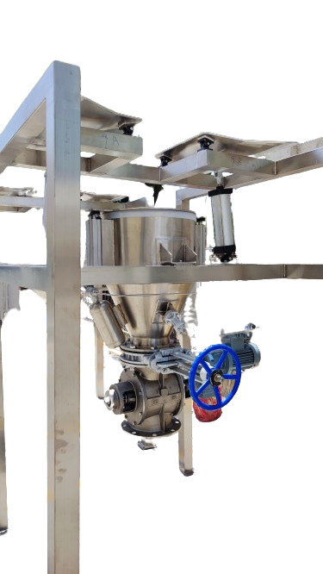
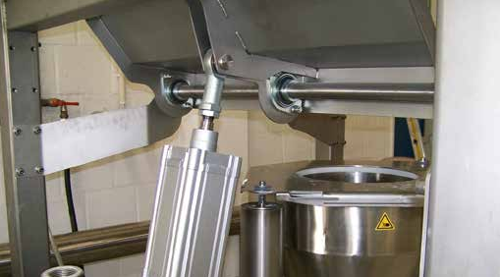
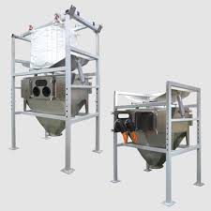
Bulk Bag Unloading Stations
BBU With Lump Breaker
YOUWEI’S lump breakers and material agitators for agglomerates and lumps can easily be docked to the BBU.
They allow for vacuum transport in a closed system free of emissions. Easy to disassemble and clean, they can also be flushed without a removal from the BBU.
Massager System Flow Aid
Dust Contaiment Filter
A YOUWEI filter-based dust collector localized on the discharge hopper maintains air quality by containing the vented product. This filtering therby reduces product losses and keeps the surrounding area clean to avoid unnecessary explosions and safeguard employee health.
The unique "no-tools“ required construction of the filter with its Quick Exchange design makes the occasional filter maintenace easy and accessible from the floor.

Slide 9
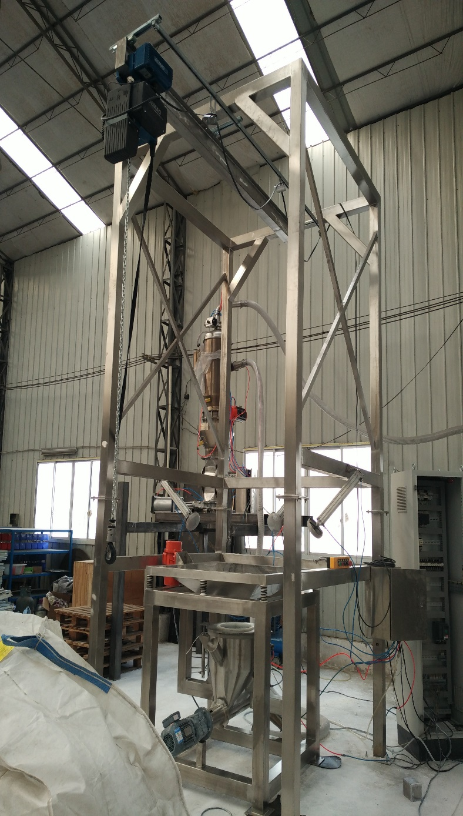
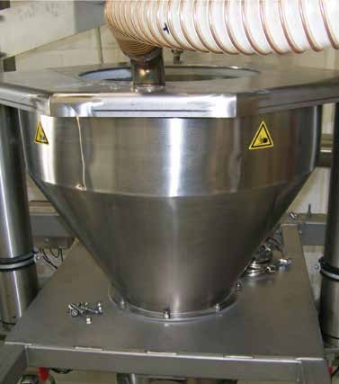
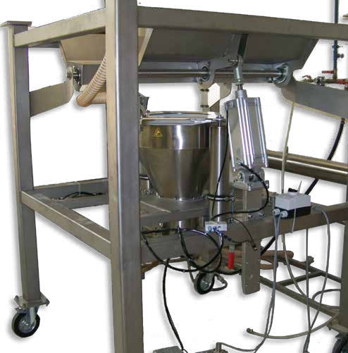
Bulk Bag Unloading Stations
Left: Hoist static BBU with pneumatic conveyor product discharge. Top: BBU base frame discharge hopper and bag container.
Bottom: Mobile fork lift BBU with optional massage paddles.

Slide 10
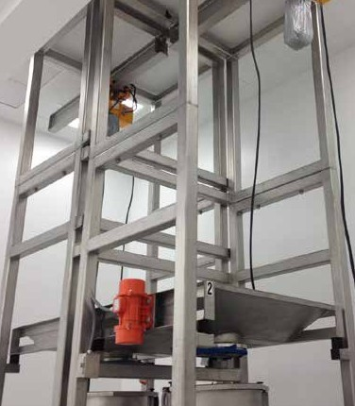
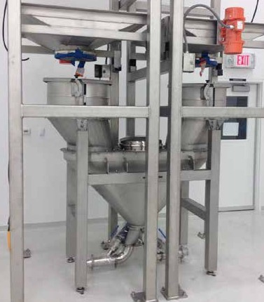
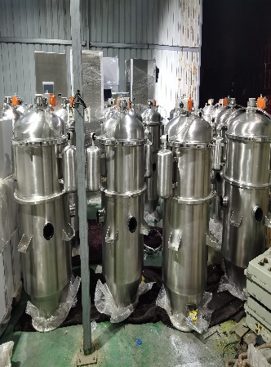
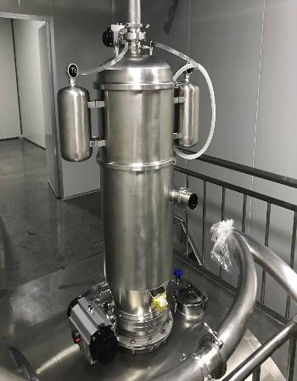
Bulk Bag Unloading Stations
Twin Set Up Saves Production Time
A twin BBU with common discharge hopper overcomes lost time through bag changes.
YOUWEI’S Vacuum Conveyors
rom the supply side to the used with a level-control
rs can transfer from as l
eam packaging oper fer hopper, Volkmann
le as 10 lbs
tons/hr. over r-friendly, and
ouble-free conveying.
YOUWEI’S BIG Bag UNLOADER Stations seamlessly integrate with Multijector Vacuum Conveyors,
offering damage-free dense phase vacuum conveying.
Optimize material flow with Volkmann conveyors, ensuring sanitary and trouble-free
transport of various bulk materials.
Choose YOUWEI'S for efficient powder, granule, and bulk material transport.
p to 200 feet, all in dust-free, ditions providing sanitary, s
mann for the optimal tr n ort of powders, granules, ellets, capsules, tablets and other b terials.

Slide 11
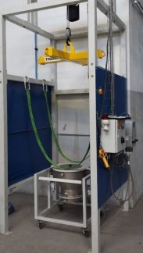
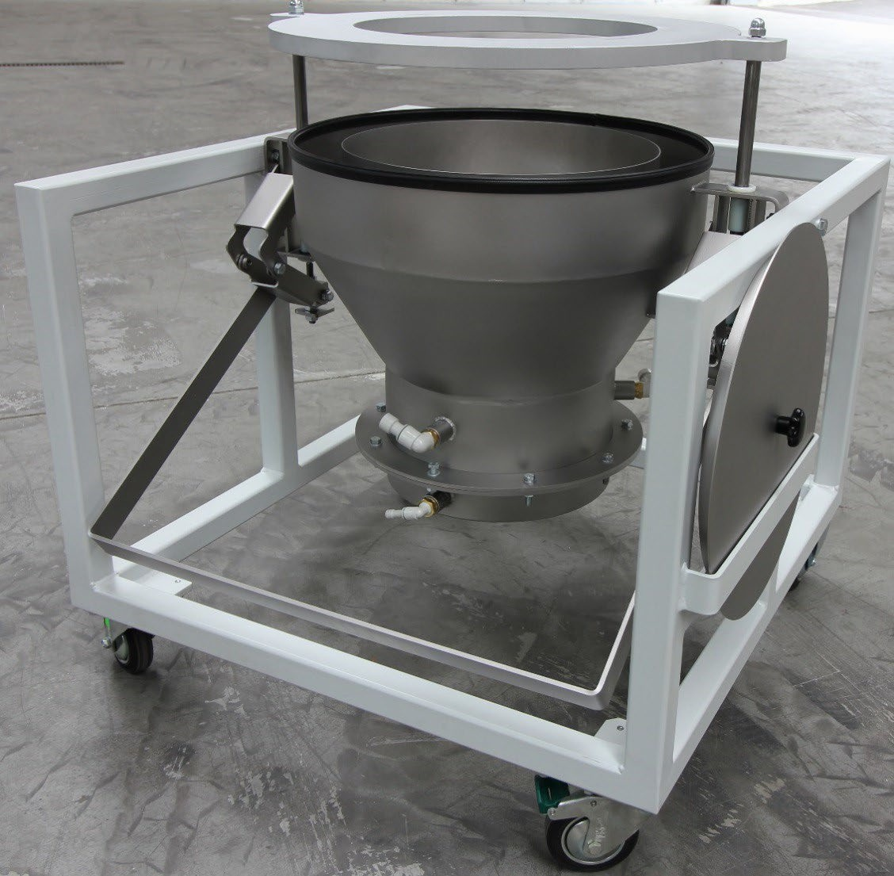
Bulk Bag Unloading Stations
Bag Change Procedure – Single Station
Initial set-up or after removing empty bag
Take Hopper trolley out of Station for easy access (only for station without z- axis drive-in units)
Deliver and place new full bag inside the station, directly under the yellow Spreader Beam
Using the hoist control pendant, lower the Spreader Beam enough to allow the hooks of the bag to be attached
Bring the BigBag into position, inside of the BigBag station
Drive down Gripper frame with hoist pendant
Connect 4 eyes of the BigBag with the Gripper hooks
Lift BigBag with control pendant
Remove transportation pallet
Connect safety belts with station frame on other side without stepping underneath the hanging load.
11. Remove top Hopper lid and put to parking position on trolley

Slide 12
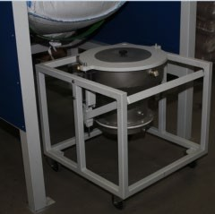
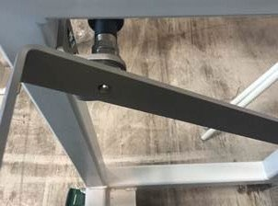
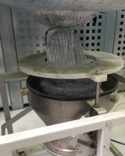
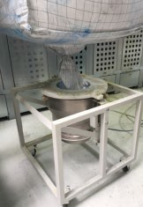
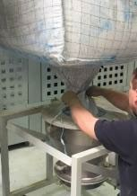
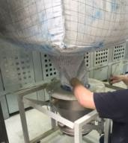
Bulk Bag Unloading Stations
12. Place Hopper trolley in correct position underneath the BigBag
13. Unlock the safety pin before opening the Hopper lid clamp by pushing handle down
Connect the BigBag sleeve to the hopper through the lid ring
Close the hopper lid clamp
Open Bag sleeve by releasing the tie to bring powder into the hopper

Slide 13
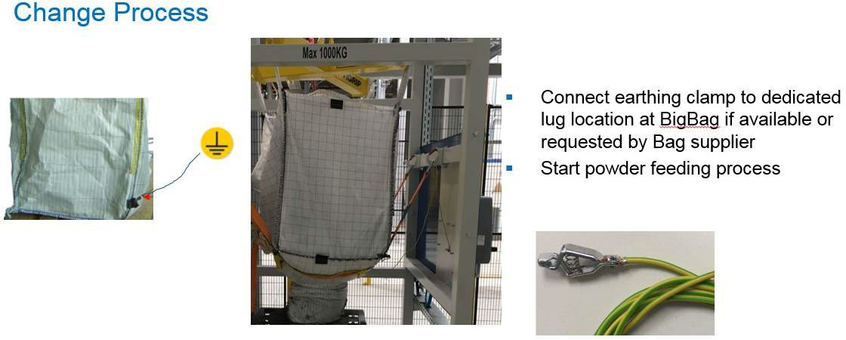
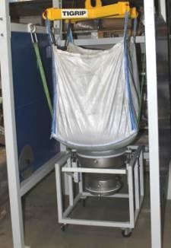
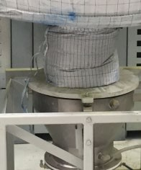
Bulk Bag Unloading Stations
Lift or adjust BigBag to proper height above hopper to achieve a straight Bag outlet sleeve
Tighten the safety belts to new position
Connect the earthing clip to the dedicated lug, located on the BigBag as shown below, or as advised by the Bag supplier

Slide 14

Invest in your operators' well-being and boost your
production efficiency with SHANGHAI YOUWEI
Contact us today to learn more!
Powered by technology and survive by quality
High cost performance-super high quality, super low price
Lifetime service
Shanghai Youwei Powder Equipment Co., Ltd.
Address: No. 351, Sizhuan Highway, Songjiang District, Shanghai
Website: www.uv-powder.com
Mail:anas@uv-powder.com
Service supervision hotline: +1(213)569-6682

